Slide 1
Myelin Water Imaging
Mar 1, 2023
UBC MRI Research Centre Analysis Resources Presentation

Slide 2

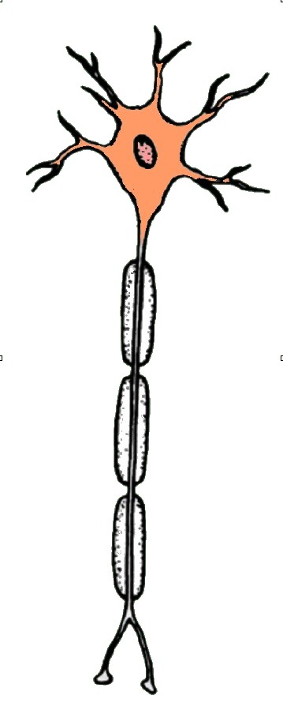
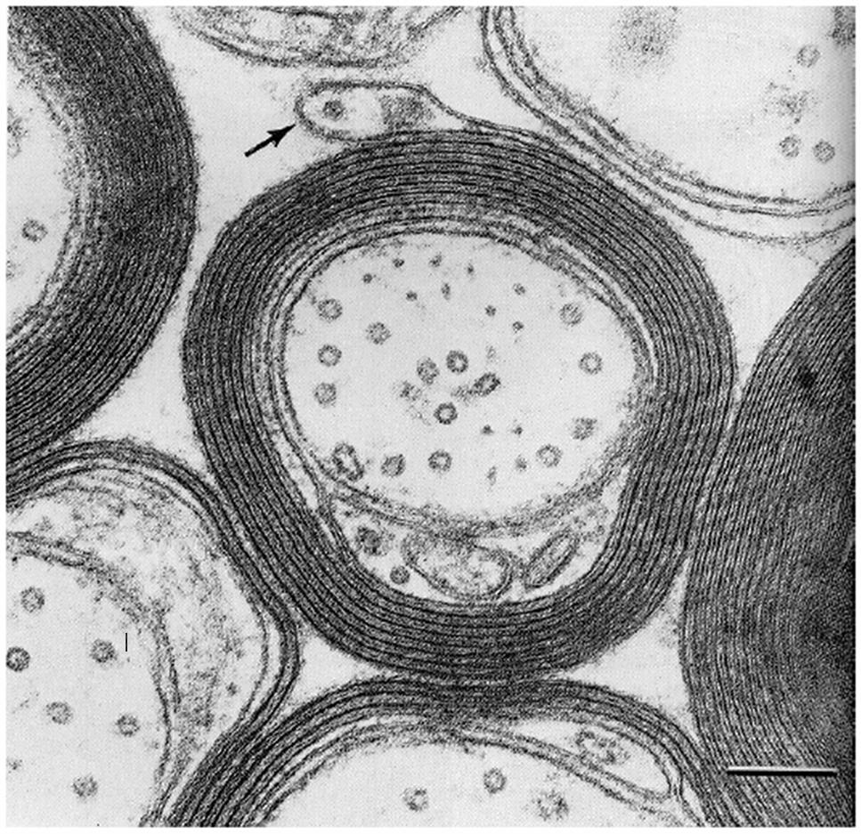
What is Myelin Water?
surface
MOG
MOG
CNP
MBP
MBP
MBP
PLP
CNP
CNP
MBP
PLP
MBP
MBP
PLP
CNP
MAG
MAG
GT1b
GD1a
Axon

Slide 3
Background
MRI measures the signal from mobile protons
generally within water molecules
Depending on their environment, protons can have different MR properties
In particular their T₂ relaxation time

Slide 4
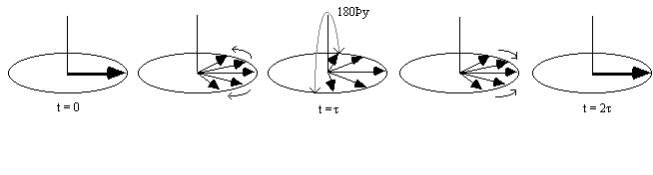
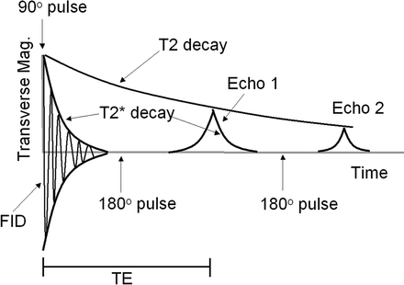
T₂ relaxation
Apply 90º
RF pulse
Apply 180º
RF pulse
Spin Echo
Formed
Dephase
…

Slide 5
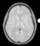
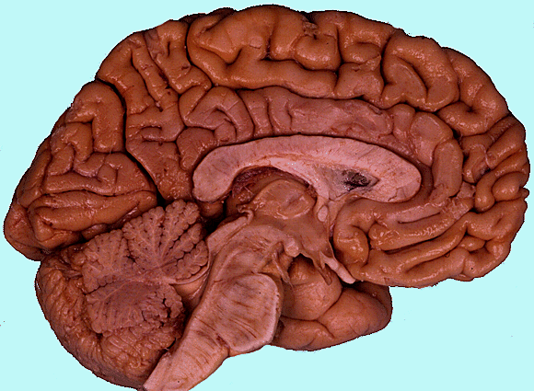
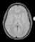
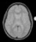
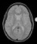
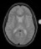
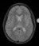
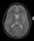
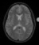
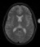
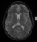
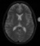
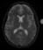
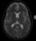
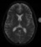
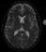
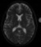
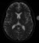
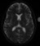
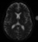
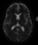
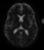
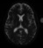
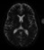
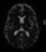
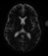
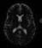

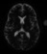
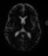
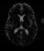
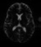
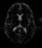
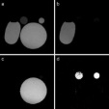
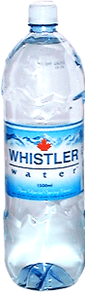
T₂ Relaxation
Heterogenous environment
Signal
Log (Intensity)
S(t) = Σ_{i=1,N} A(T_{2i}) e^{-TE/T2i}
Homogeneous environment
TE (ms)

Slide 6
T₂ Analysis
Need to decompose the decay curve into exponential components
Use Non-negative least-squares (NNLS) algorithm
Decompose into a T₂ distribution
Each exponential component represents a different water pool

Slide 7

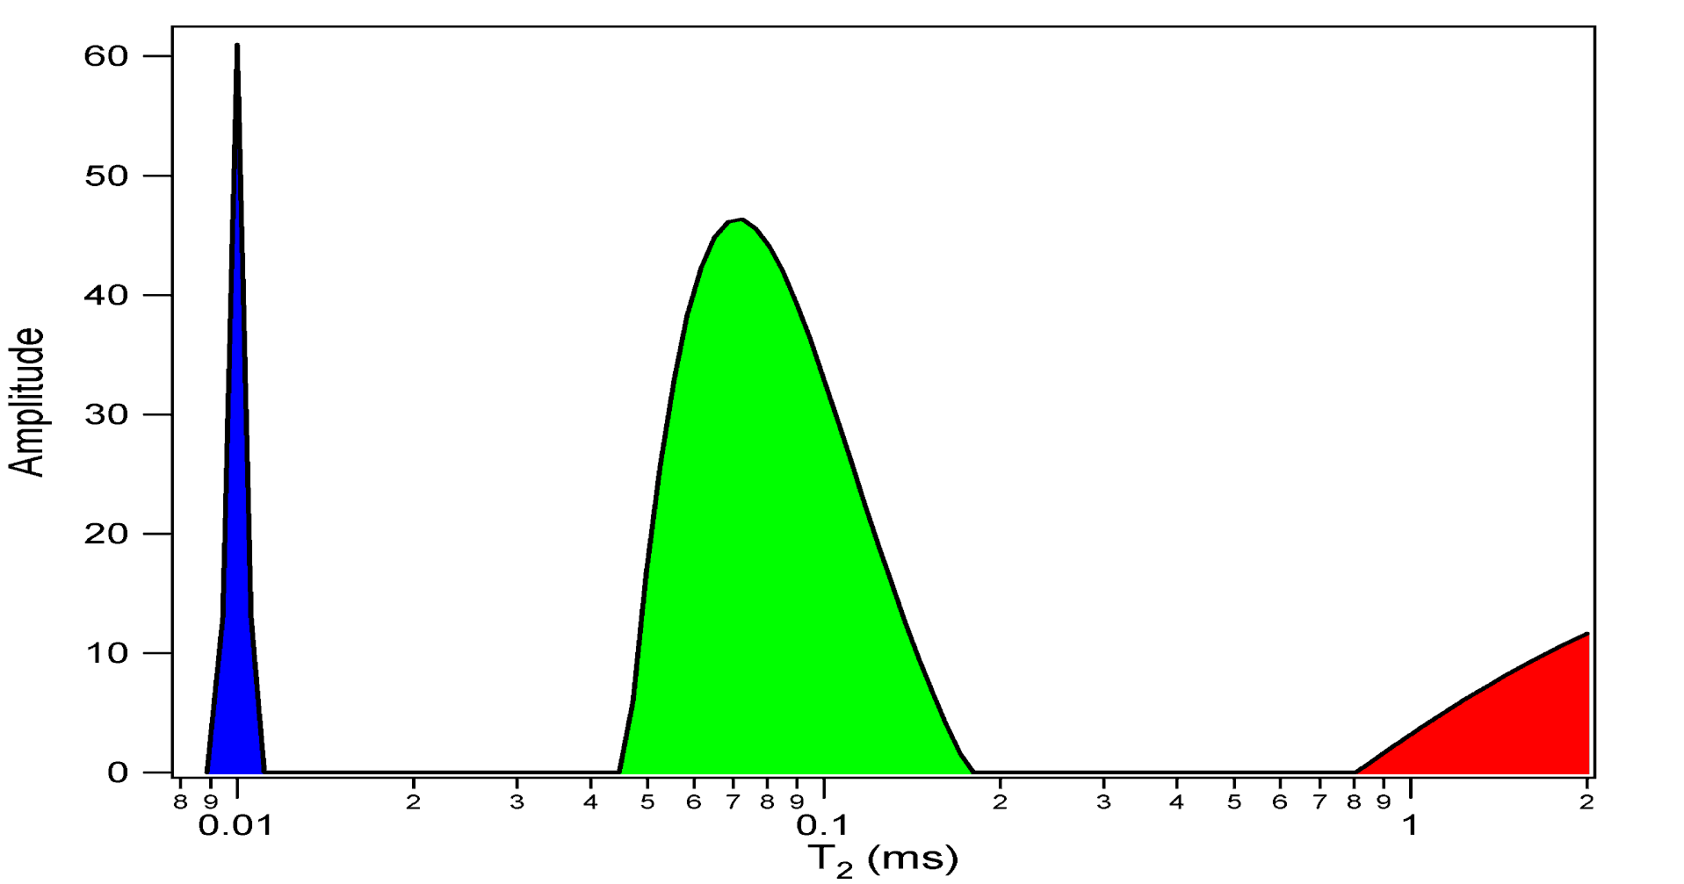
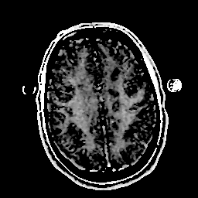
T₂ Distribution
Intra & extracellular water
Myelin Water Fraction (MWF)
=
+
A(T₂)
Myelin Water
T₂ time (s)

Slide 8
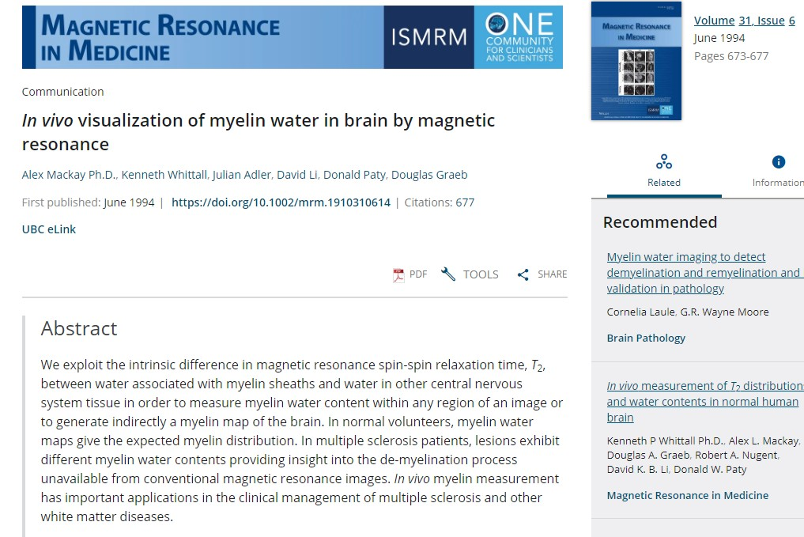
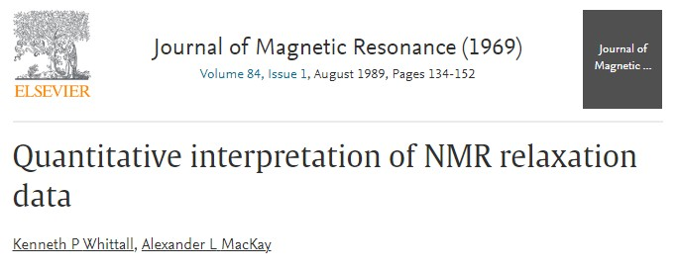
Some History
1st Paper on in-vivo human MWI
Paper on using NNLS for T₂ relaxation

Slide 9
Some History
MWI 1st applied to the study of multiple sclerosis
Many other conditions have now been studied
NMO, PKU, TBI, stroke, schizophrenia, aging, FASD, ALS/PLS, …

Slide 10
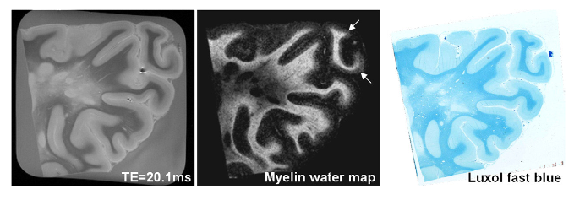
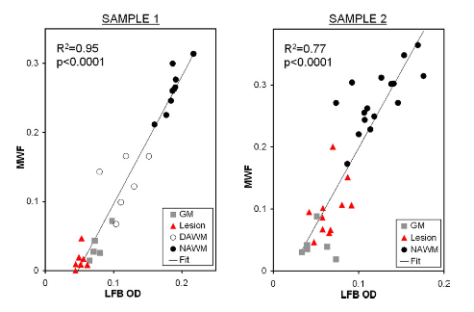
MWF Validation
Myelin water fraction (MWF) matches intensity of luxol fast blue (stain for myelin lipids)
Ref: Laule, C., Kozlowski, P., Leung, E., Li, D. K., Mackay, A. L., & Moore, G. R. (2008). Myelin water imaging of multiple sclerosis at 7 T: correlations with histopathology. NeuroImage, 40(4), 1575–1580. https://doi.org/10.1016/j.neuroimage.2007.12.008

Slide 11
Advances in MWI
Moving from single slice 2D to a 3D acquisition
We also moved from 1.5T to 3T
Burkhard Mädler and Shannon Kolind
Introducing gradient echoes to speed up acquisition (GRASE)
Prasloski, T., Rauscher, A., MacKay, A. L., Hodgson, M., Vavasour, I. M., Laule, C., & Mädler, B. (2012). Rapid whole cerebrum myelin water imaging using a 3D GRASE sequence. NeuroImage, 63(1), 533–539. https://doi.org/10.1016/j.neuroimage.2012.06.064
Adding the extended phase graph algorithm for stimulated echo correction and flip angle optimisation
Prasloski, T., Mädler, B., Xiang, Q.-S., MacKay, A. and Jones, C. (2012), Applications of stimulated echo correction to multicomponent T₂ analysis. Magnetic Resonance Medicine, 67: 1803-1814. https://doi.org/10.1002/mrm.23157
Adding more echoes (moving 32 to 48)
Zhang J, Vavasour I, Kolind SH, Baumeister B, Rauscher A, MacKay AL. Advanced myelin water imaging techniques for rapid data acquisition and long T2 component measurements. Proc Intl Soc Mag Reson Med 23;2015, p. 824.

Slide 12
How to analyse MWI
Sign up for our github MWI resources
https://mriresearch.med.ubc.ca/news-projects/myelin-water-fraction/
Our traditional method uses in-house matlab software that incorporates NNLS and EPG.
But this software is rather slow
Newer software is written in julia: DECAES
https://github.com/jondeuce/DECAES.jl

Slide 13
Matlab NNLS code
Read in data to matlab
>> rec2mat(‘filename.REC’);
Load the created .mat file
>> load(‘filename.mat’);
Run T2maps.m
>> [maps,distributions]=T2maps_SEcorr(scan.image, TE, ’0.008’, T2range, [0.01,2.0]);
Run T2part (to divide into different water pools)
>> [moremaps]=T2part_SEcorr(distributions,T2range, [0.01,2.0], spwin, [0.009,0.04]);

Slide 14
Outputs
There are a few conventions
First letter refers to water pool:
g = global (whole distribution)
s = short (short T2 component, ie myelin water)
m = middle (intra/extracellular water)
Other letters refer to measurement
fr = fraction
gm = geometric mean
dn = density
va = variance
So the myelin water fraction = sfr

Slide 15
DECAES
Put all T₂ echoes into one .nii file
use fslmerge
Run the decaes code in julia
julia --threads=auto decaes.jl -- image.nii --T2map --T2part --TE 8e-3 --nT2 40 --T2Range 10e-3 2.0 --SPWin 10e-3 40e-3 --MPWin 40e-3 200.0e-3 --Reg chi2 --Chi2Factor 1.02
Output is divided into .mat files with T2map (global variables) and T2part (partitioned variables such as sfr)

Slide 16
Some extra bits
Unfortunately, now all the results are in matlab so need to be converted to .nii
use make_nii and save_nii to do this
Make sure that your resulting MWF image is not flipped L/R or in a different space to the original T2 echoes.
use fslswapdim (for R/L swap) or fslcpgeom (for different space)

Slide 17
What’s new in the world of MWI
METRICS
Dvorak, AV, Wiggermann, V, Gilbert, G, et al. Multi-spin echo T₂ relaxation imaging with compressed sensing (METRICS) for rapid myelin water imaging. Magn Reson Med. 2020; 84: 1264– 1279. https://doi.org/10.1002/mrm.28199
instead of using the gradient echoes like GRASE, uses compressed sense to speed things up
we like the 56 echo version with TE=7ms, 1.5mm³ isotropic, scan time~14min
it’s analysed the same as before

Slide 18
What’s new in the world of MWI
CALIPR (Constrained, Adaptive, Low-dimensional, Intrinsically Precise Reconstruction)
Dvorak A, ISMRM 2022, p2851
uses under sampling with temporally-incoherent sampling schemes
allows whole brain MWI in <5min
complicated data reconstruction
not quite ready for prime time (but close)

Slide 19
Machine Learning and MWF
Spectrum Analysis for Multiple Exponentials via Experimental Condition Oriented Simulation (SAME-ECOS)
https://github.com/hanwencat/SAME-ECOS
Based on a combination of the resolution limit constraint and machine learning NN algorithm
Results in more robust T₂ distributions and faster analysis
Liu, H, Joseph, TS, Xiang, Q-S, et al. A data-driven T₂ relaxation analysis approach for myelin water imaging: Spectrum analysis for multiple exponentials via experimental condition oriented simulation (SAME-ECOS). Magn Reson Med. 2021; 87: 915– 931. https://doi.org/10.1002/mrm.29000
Deep learning implementation of our NNLS analysis
used to speed up analysis to <1min
Trained on 32-echo GRASE data from brain
H Liu, Q-S Xiang, R Tam, AV Dvorak, et al. Myelin water imaging data analysis in less than one minute. NeuroImage. 2020:210;116551. https://doi.org/10.1016/j.neuroimage.2020.116551.

Slide 20
MWI on GE scanners
Jing has recently developed a GRASE sequence so we can collect data on PET/MR.
1x1x2.5mm³ reconstructed matrix size, scan time 12:50min, TE=10ms, TR=1s, 32 echoes

Slide 21
MWI with other scanner vendors
Sequence available for all vendors
All our MWI flavours are available on the Philips Elition
On GE, Jing recently developed a GRASE sequence
METRICS and CALIPR may also be available
On Siemens, Jongho Lee has developed a GRASE sequence for some software releases
Also have GRASE on the pre-clinical Bruker scanners

Slide 22
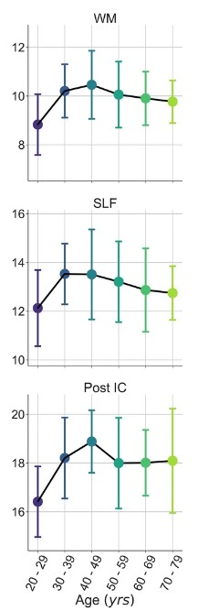
MWF Atlas
Adam Dvorak has developed a MWF atlas created with 48-echo GRASE in 100 controls
Allows personalised z-score analysis
Shows an age dependence
Dvorak, A.V., Swift-LaPointe, T., Vavasour, I.M. et al. An atlas for human brain myelin content throughout the adult life span. Sci Rep 11, 269 (2021). https://doi.org/10.1038/s41598-020-79540-3

Slide 23
Some last remarks
MTR, radial diffusivity and T1w/T2w are not myelin measures
We can also get other measurements out of multi-echo T₂ data such as the geometric mean T₂ of the intra/extracellular water component
Related to tissue microstructure and water content
Let us know if you want to do MWI. (It’s our big thing.)
We can help!

Slide 24
Next meeting
April 5th
Topic:

